Slide 1

Blockchain Application for Healthcare
Graduation project

Slide 2


Under the supervision of:
Prof. Walaa Elhady
Professor at The Egyptian
E-Learning University
T.A. Yousif Ayman
Teaching Assistant at The Egyptian
E-Learning University
Yousef Ayman Metry
Mark Moheb Mamdouh Noran Salah Khalifa
Amira Zakaria Fahem Mariam Mina Beshay
Aml Samouel Haana Maria Eldbea Anis

Slide 3

What is Blockchain ?
Decentralized.
Distributed ledger.
Record transactions across many computers.
Can’t change any old block.

Slide 4
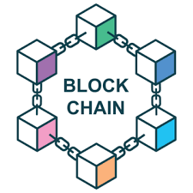
CREATING A BLOCKCHAIN
So simply blockchain is a chain of blocks that contains information
Note: Genesis Block or Block Zero is the first block in Blockchain.
3 Steps To Creating Blockchain :-
1.Create a block.
2.Link blocks
3.Add to the chain

Slide 5
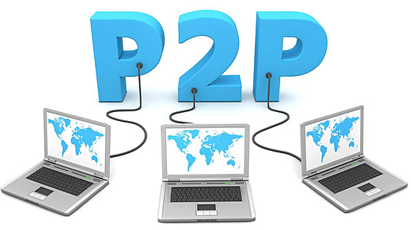
Peer-to-Peer (P2P):-
Operates on decentralization.
Conduct transactions without need for a third party.
Promoting cooperation.
Deal management.
Peers in a blockchain network are nodes with equal power and tasks.

Slide 6
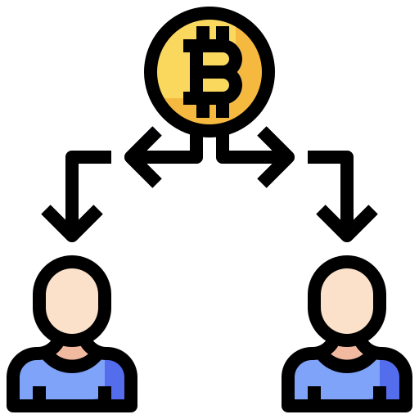
Bitcoin:-
Bitcoin is the first blockchain application.
The bitcoin design has inspired other applications.
The implementation of the blockchain within bitcoin made it the first digital currency to solve the double-spending problem.

Slide 7
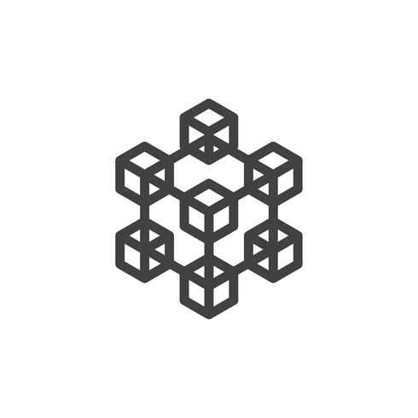
Types of blockchain
1. Public )PERMISSIONLESS(:
A public blockchain is decentralized and secure.
2. Private )PERMISSIONED(:
Private blockchain allowing only specific nodes to share information.

Slide 8

Background
The project talks about how to keep the patient’s medical history:
Blood type,
Tests,
X-rays,
Chronic diseases.
Unconscious
In addition, blockchain makes it easier for the doctor to know everything about the patient.

Slide 9
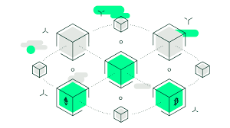
Blockchain Frequently Used Terms
1. Ledger
2. Hash Function
3. Consensus
4. Smart Contract
5. Solidity
6. Nonce
7. Longest Chain Rule

Slide 10
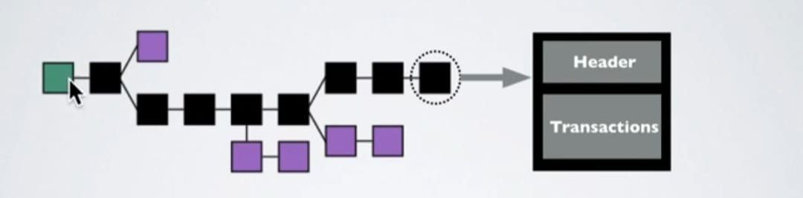
1. Ledger
A database or a list of every transaction.
It maintained by a network of computers or nodes.
Public and Private.

Slide 11
2. Hash Function
Mathematical function.
The fixed-length output is known as the hash value.
Should have the following properties:
1- Collision resistant.
2- Preimage resistance.
3- Deterministic.
4- Avalanche Effect.
5- Puzzle Friendliness.
6- Fixed-length Mapping.
7- Quick Computation.

Slide 12
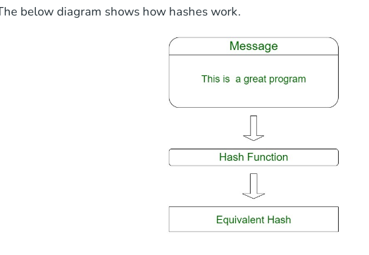
2. Hash Function
How does Hash Function work?
Takes the input of variable lengths.
Returns outputs of fixed lengths.
Types of Hashing :
MD5.
SHA-256.
CRC32.
RipeMD.
Tiger.
xxhash.

Slide 13

2. Hash Function
Uses of Hash Functions in Blockchain:
Merkle Tree.
Proof of Work Consensus.
Digital signatures.
The chain of blocks

Slide 14

2. Consensus
Consensus Mechanism
Node Agreement
Protocol Adherence
Transaction Validity
Trustless System

Slide 15
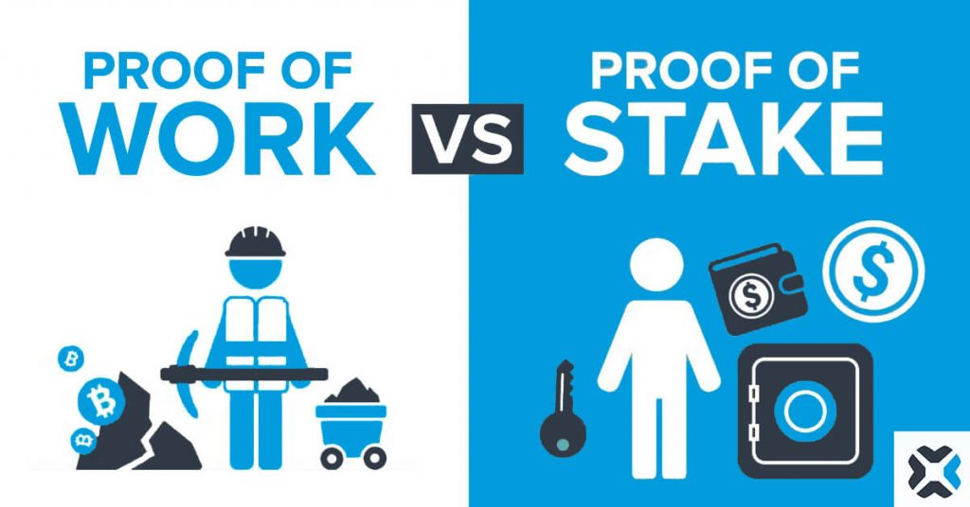
Types of consensus :-
Proof of Work (POW) | Proof of Stake (POS)
POW in Blockchain | Validation Mechanism
Mining Process | Algorithm Variations
Transaction Validation | Blockchain Security
Incentives for Miners | Node Selection
Security Enhancement | Staking Duration

Slide 16
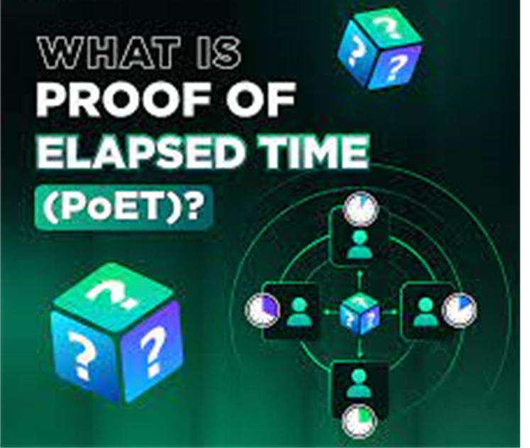
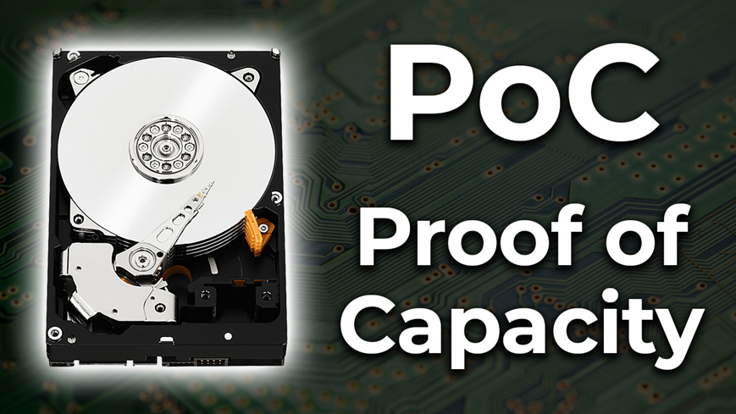
Types of consensus :-
Proof of Capacity (POC):- | Proof of Elapsed Time (POET):-
Proof of Capacity algorithm focuses on determining the storage capacity available for validation. | The "Proof Elapsed Time" consensus mechanism takes into consideration the time factor.

Slide 17

Types of consensus :-
Proof of authority :-
Emitted Authorized Participants
No Computational Power Requirement
Centralized Authorization
Private Blockchain Security
Simplicity of Validation
￼

Slide 18
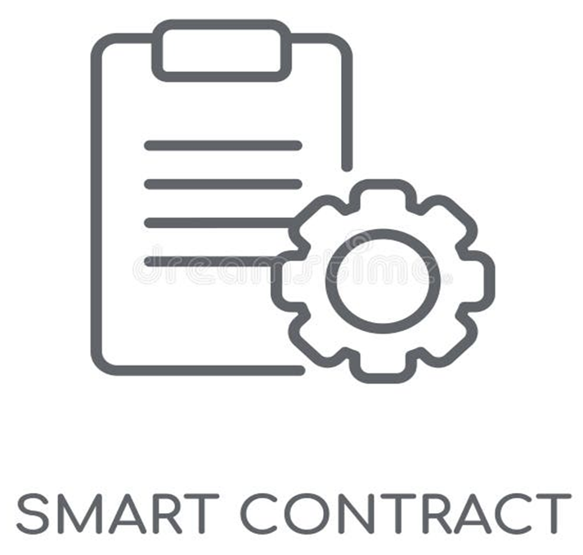
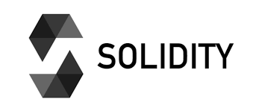
Blockchain Frequently Used Terms
4. Smart Contract:
Computer protocols.
Distributed across nodes.
Automatically activated when certain conditions are met.
Eliminating the need for a trusted third-party.
5. Solidity:
Object-oriented programming language.
Designed for writing smart contracts on blockchain platforms like Ethereum.

Slide 19
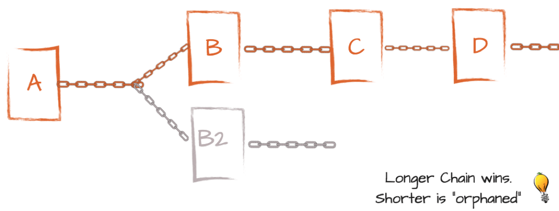
Blockchain Frequently Used Terms
6. Nonce:
Small piece of data.
Constantly changing to ensure that the hash is not duplicated.
7. Longest Chain Rule:
Ensures that nodes follow the longest chain.
Maintain the validity of the blockchain.

Slide 20
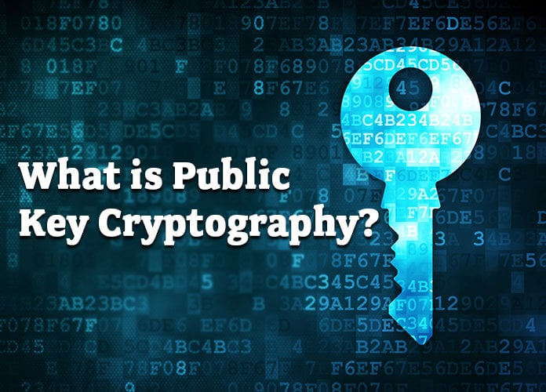
Public key cryptography
Public Key for All
Unique Private Key
Collaborative Unlocking

Slide 21
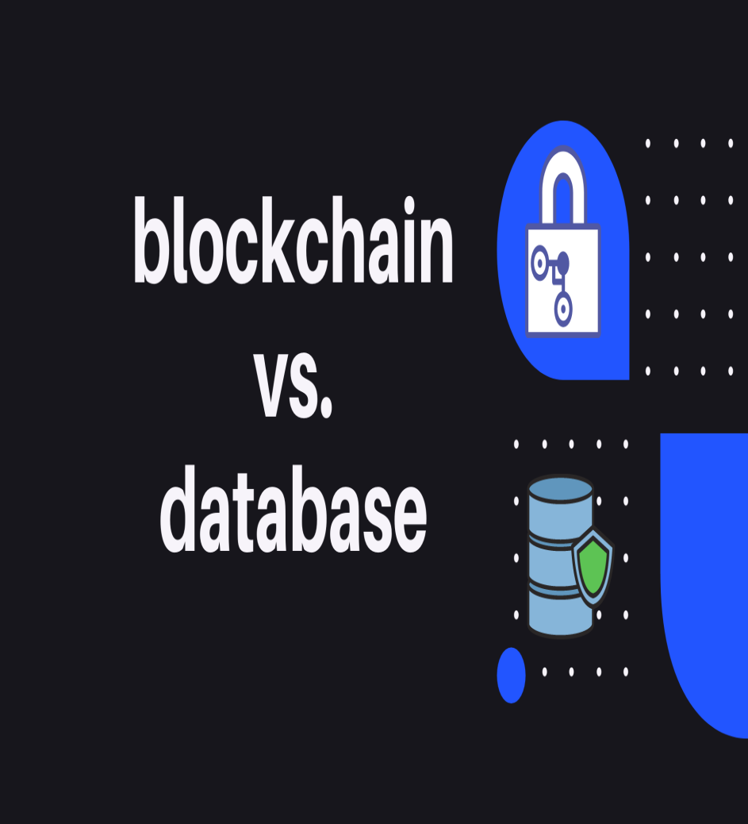
What is the difference between a database and a blockchain?
Storage
Admin
Modifying

Slide 22

How can blockchain be used in healthcare?
Securing Patient Data
Unlocking Genetic Code
Encrypting Patient Records
Accelerating Information Transfer

Slide 23
Project Structure
Frontend:-
Backend:-
Doctors blocks
Doctor info.
Add/Edit Doctor
Patients blocks
Patient info.
Add/Edit Patient
Drugs blocks
Drug info.
Add/Edit Drug
Admin Dashboard
Healthcare Home
Blockchain.js
Server.js

Slide 24
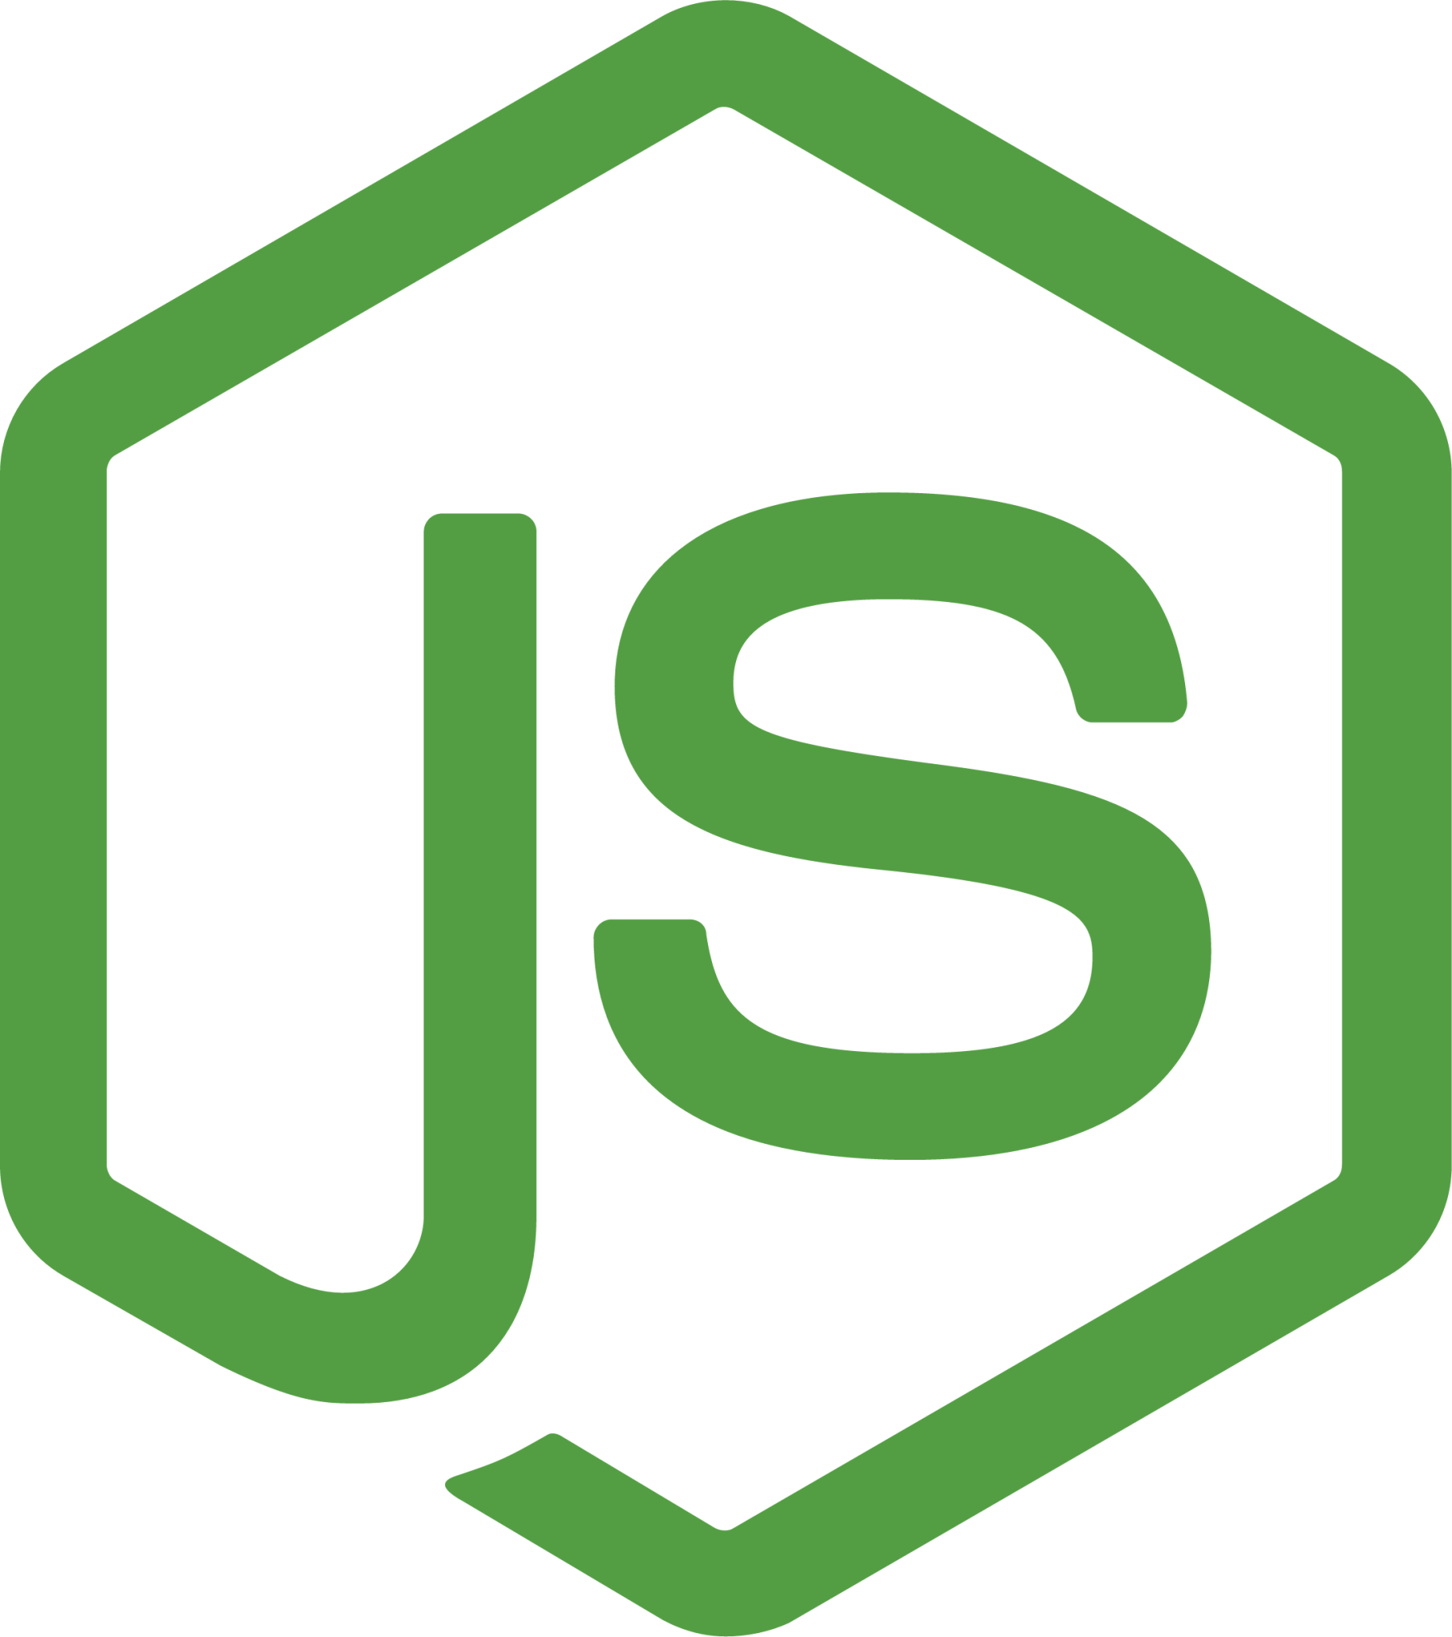
Node.js
JavaScript runtime environment outside of web browsers
Built on Chrome's V8 JavaScript engine.
Enables development of scalable, high-performance network applications.
Open-source and cross-platform (Windows, Linux, macOS).
Supports asynchronous, event-driven programming model.
Includes a robust package manager (NPM) for easy dependency management

Slide 25

SQLite
SQLite Overview
Storage
Features
Use Cases
Operations

Slide 26
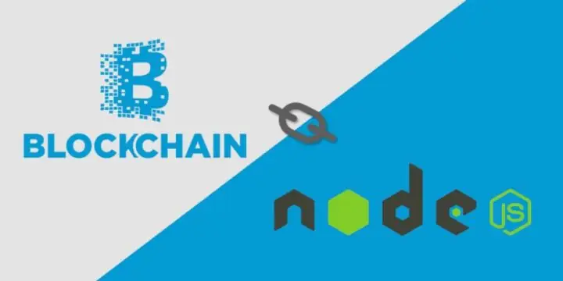
Blockchain Integration with Node.js
Hashing
Block Structure
Data Representation

Slide 27
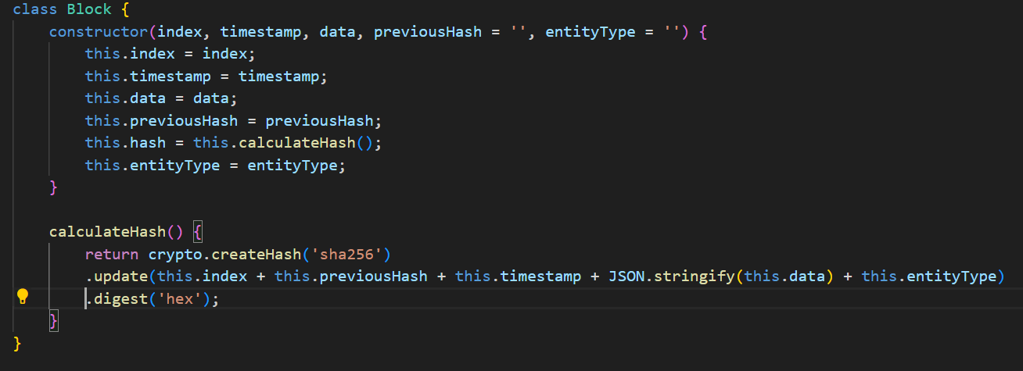
Blockchain.js
Block Class
Blockchain Class
Hashing
Integrity Check

Slide 28
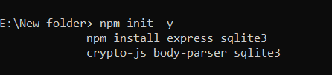
Server.js
Initial Setup
Import Required Modules
Initialize Express Application and Middleware
Initialize Databases
Function to Add Block to Blockchain

Slide 29
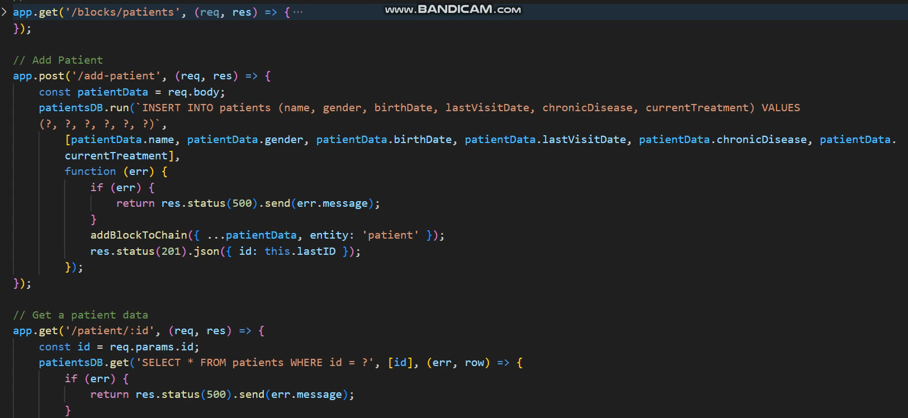
Server.js
Patients Routes :-
Get All Patients Blocks
Add a New Patient
Get a Patient's Data
Update a Patient's Data
Delete a Patient

Slide 30
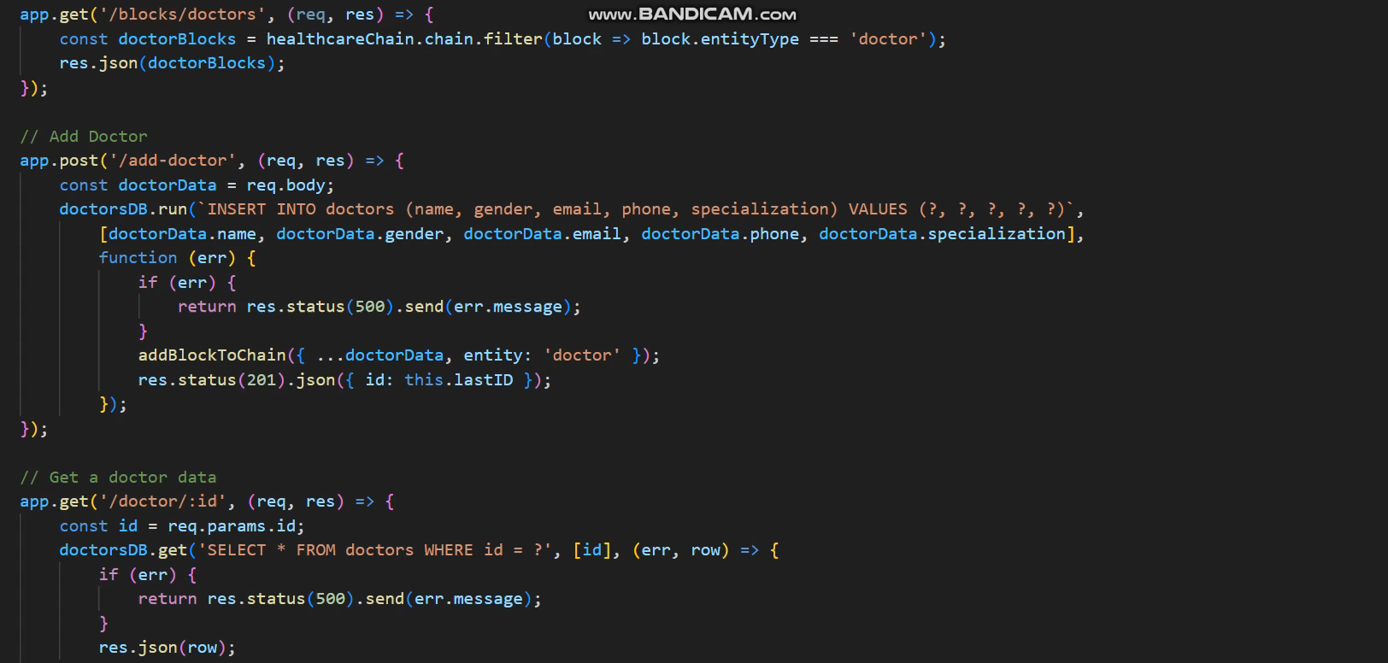
Server.js
Doctors Routes :-
Get All Doctors Blocks
Add a New Doctor
Get a Doctor's Data
Update a Doctor's Data
Delete a Doctor

Slide 31
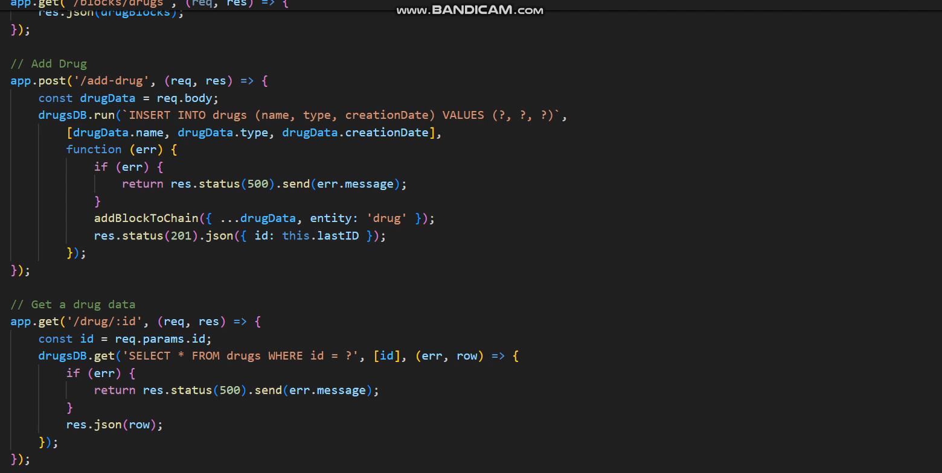
Server.js
Drugs Routes :-
Get All Drugs Blocks
Add a New Drugs
Get a Drugs's Data
Update a Drug’s Data
Delete a Drug's

Slide 32
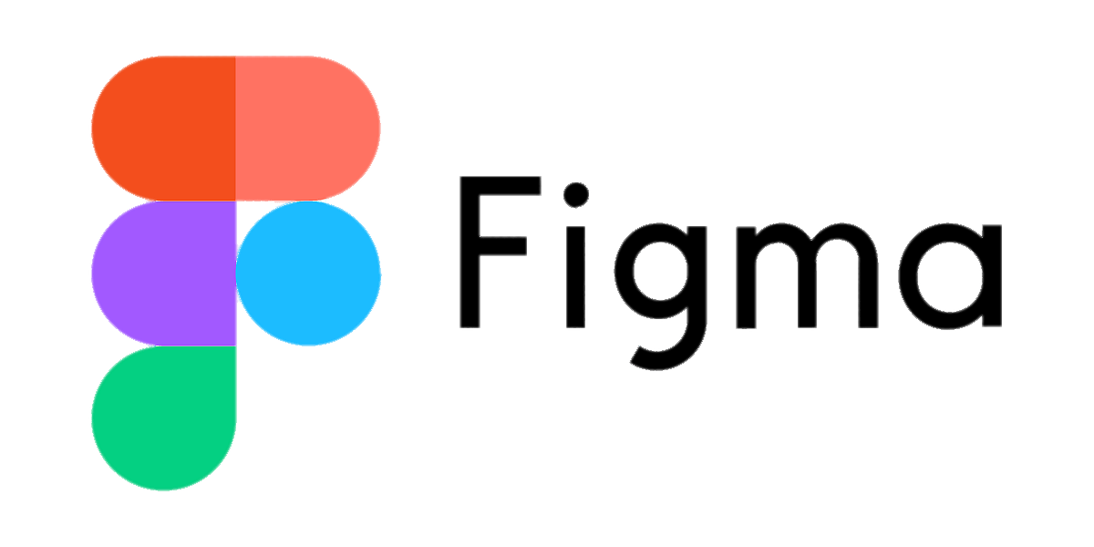
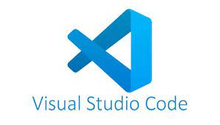

Tools Used

Slide 33
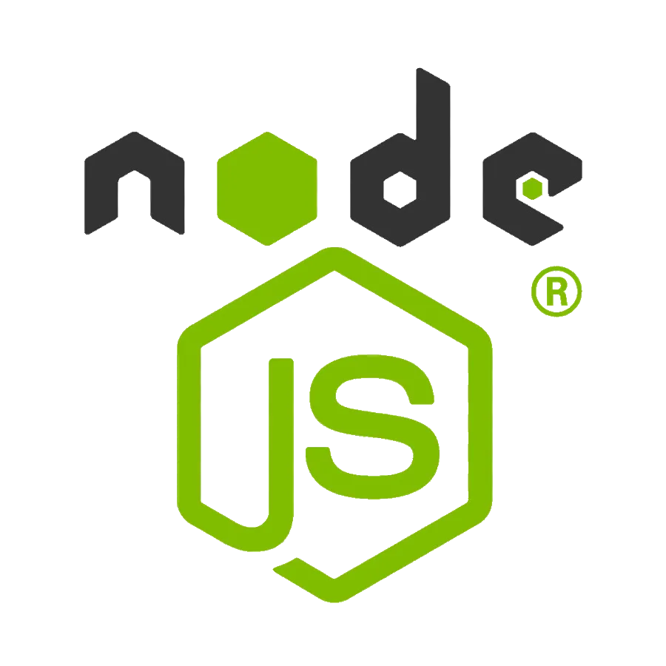
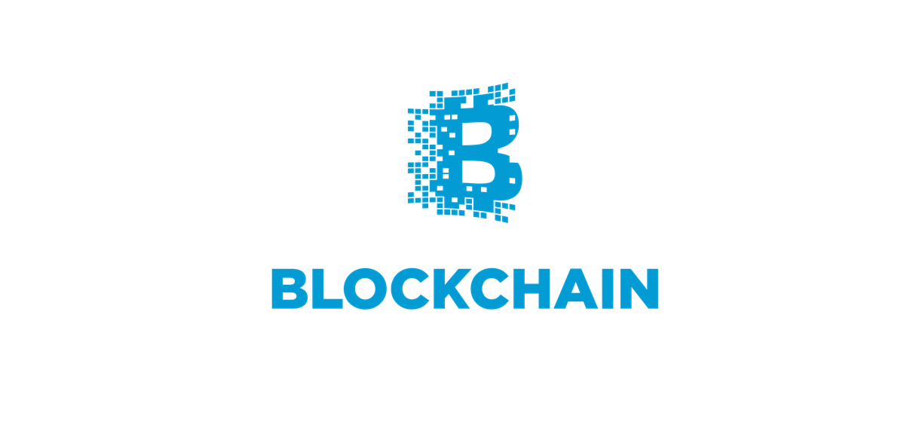
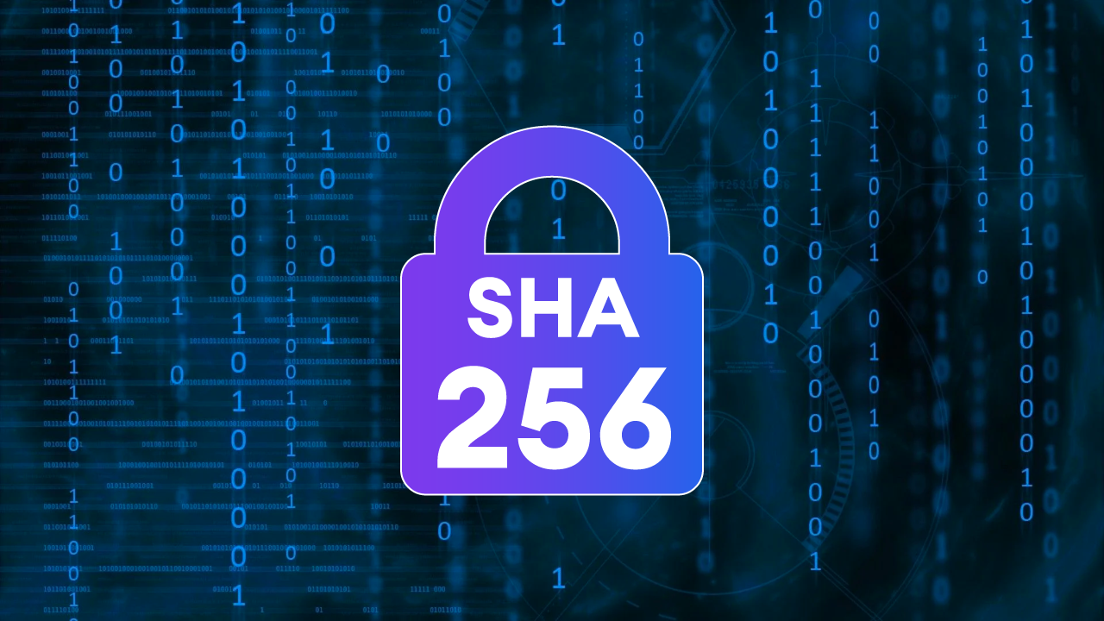

Technologies Used
Crypto JS (SHA256)

Slide 34

Demo Video
We are excited to share with you a key aspect of our project through a short video.
This video will provide an overview of our project's objectives, the process we followed, and the outcomes we achieved.

Slide 35

Future Work
1. Developing new platforms for managing patient records
2. Creating new systems for supply chain management
3. Developing applications that allow secure and reliable
4. Establishing secure payment systems based on blockchain technology
5. Developing solutions for securely managing patient identities.

Slide 36


Conclusion
Therefore, Blockchain is the best way to save patient data as:
it records data from oldest to newest.
which makes it easier for the doctor to know the patient’s medical history correctly.
Blockchain has high security , when we use Blockchain it prevent any data tampering or stealing.

Slide 37


